Slide 1
Horizontal Pod Autoscaling
OW

Slide 2
What is Horizontal Pod AutoScaling
In Kubernetes, a HorizontalPodAutoscaler automatically updates a workload resource (such as a Deployment or StatefulSet), with the aim of automatically scaling the workload to match demand
Horizontal scaling means that the response to increased load is to deploy more Pods.
If the load decreases, and the number of Pods is above the configured minimum, the HorizontalPodAutoscaler instructs the workload resource (the Deployment, StatefulSet, or other similar resource) to scale back down.
Horizontal pod autoscaling does not apply to objects that can't be scaled (for example: a DaemonSet.)

Slide 3
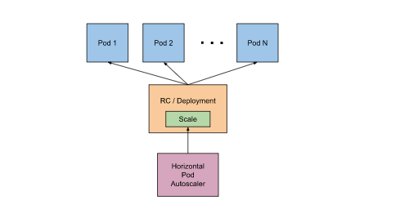
How does a HorizontalPodAutoscaler work?
HorizontalPodAutoscaler controls the scale of a Deployment and its ReplicaSet

Slide 4
..
Kubernetes implements horizontal pod autoscaling as a control loop that runs intermittently (it is not a continuous process). The interval is set by the --horizontal-pod-autoscaler-sync-period parameter to the kube-controller-manager (and the default interval is 15 seconds).
Once during each period, the controller manager queries the resource utilization against the metrics specified in each HorizontalPodAutoscaler definition. The controller manager finds the target resource defined by the scaleTargetRef, then selects the pods based on the target resource's .spec.selector labels, and obtains the metrics from either the resource metrics API (for per-pod resource metrics), or the custom metrics API (for all other metrics).

